Slide 1
Virtual
13
Memory

Slide 2
The Virtual
I just want to use this time to point out that “Virtual Reality” is an oxymoron.

Slide 3
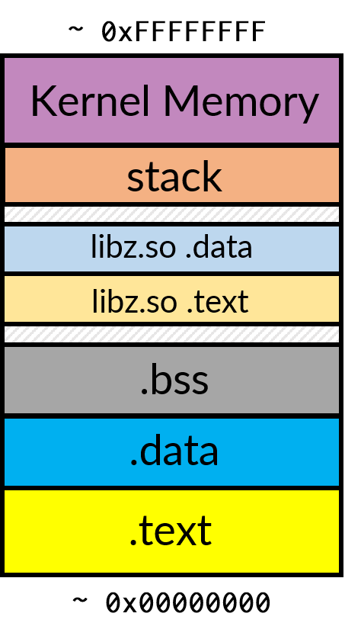
Our protagonist’s journey so far…
Processes have an addressable memory space.
  We call this an address space.
Now, we know it has some obvious things…
  The code (.text)
  The data (.data)
  A stack and some available space that can be
  allocated as we need it.
We added the “Kernel” memory to our diagram.
  This is the OS code and data.
  For system processes to run, they need to be
  resident in memory as well.

Slide 4
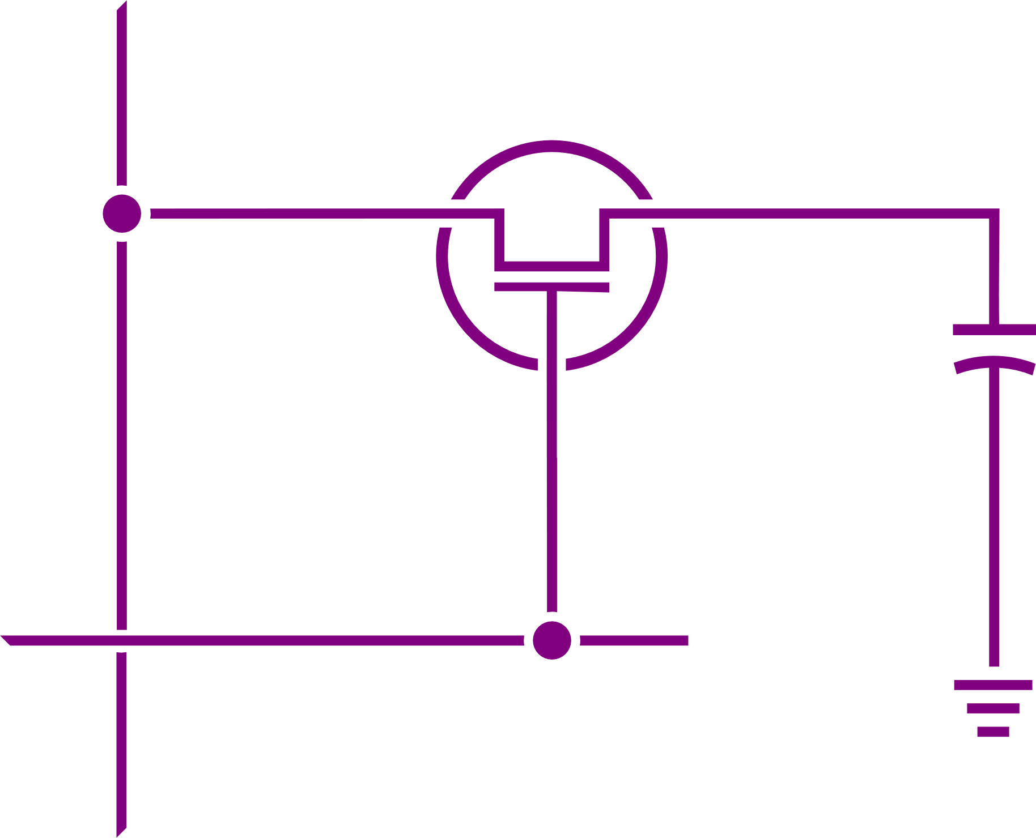
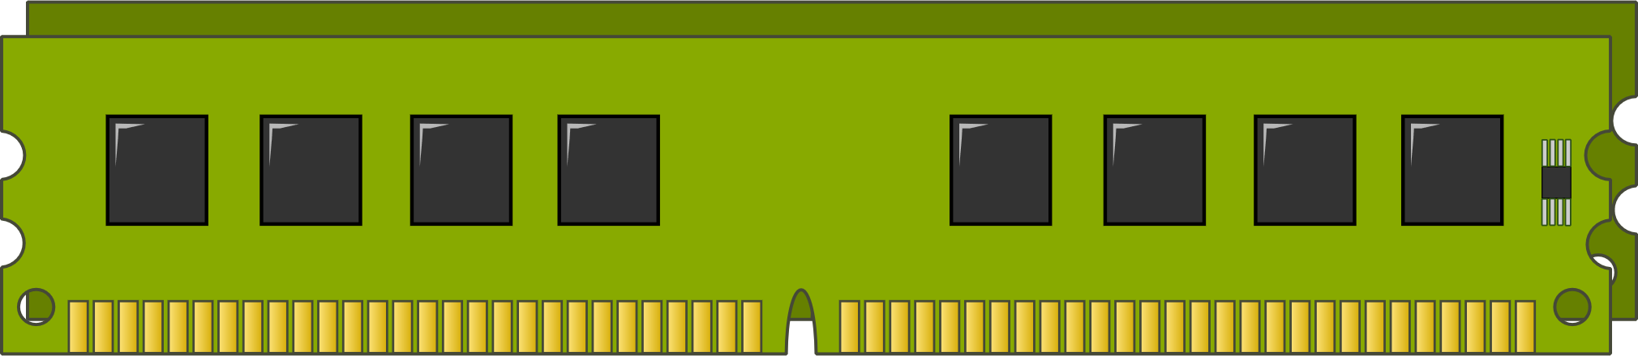
Random Access Memory
Sense Line
Memory is a physical device.
It is a random access device.
  Allows the machine to access data at any point.
As opposed to sequential access.
Capacitor
Control
Line
Dynamic RAM (DRAM)

Slide 5
Let’s get physical
0xFFFFFFFF
Physical addressing is when hardware relates a program address directly to the memory hardware.
The program addresses are the exact physical locations of data.
0x00000000
Dynamic RAM (DRAM)

Slide 6

Let’s get physical
0xFFFFFFFF
Physical addressing is useful when you have only a single, simple process.
Embedded devices (small, specific uses)
Think of your toaster… or a thermostat.
Memory load
Address 0x1040
Physical
Address
0x1040
Address Space
0x00000000
CPU
Dynamic RAM (DRAM)

Slide 7
The problem
However, we don’t always have such simple cases.
  A general-purpose system, like our phones and desktop machines, can run a variety of programs.
  We often have multitasking operating systems running many programs at the same time.
When we have several processes, how to we manage memory?
  How to present a consistent address space?
  How to prevent other processes from interfering?
  How to prevent address space fragmentation?
The solution, as usual: indirection: Virtual Memory.

Slide 8
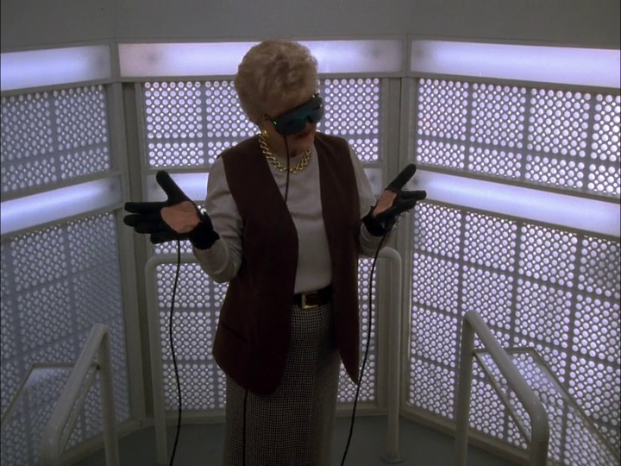
Virtual vs. Reality
Just like “virtual reality,” we create a world that resembles reality, but it really is a facsimile.
We can provide a scheme, backed by hardware, that allows memory addresses to be seen by programs in a specific place…
Yet, those addresses differ from the actual physical memory location.
Angela Lansbury as Jessica Fletcher, Director Lee Smith
Murder, She Wrote; “A Virtual Murder”
Universal Studios, Universal Television, 1993

Slide 9
Consistency, dear Watson.
When you write a program, do you write it deliberately for the memory layout of your OS?
  No!
The OS loads executables to specific places in memory.
  The program expects data to be in a specific place.
  The program expects memory to be “large enough.”
So, we will look at one strategy to define well-known stretches of memory (virtually) that are mapped to physical memory (in reality.)

Slide 10
Segmentation
It’s not just a type of fault.

Slide 11
Segmentation
Segmentation is a virtual memory system where spans of physical memory called a segment are given a physical base address.
The application refers to the virtual address by its segment index which is translated by hardware into the real address behind-the-scenes.
Here, we have a segment table which defines two segments.
  The first segment defines a range of addresses from 0x7fde0000 to 0x7fde2fff.
  Second is 0x23fa0000 to 0x23fa3fff
Segment Table
Index | Physical Base | Size
00 | 0x7fde0000 | 0x3000
01 | 0x23fa0000 | 0x4000
02 | NULL | 0

Slide 12
Address Translation
0xFFFFFFFF
The Memory Management Unit (MMU) is a hardware component of your CPU that translates virtual addresses to physical addresses.
Here, it translates based on the segment table.
Segment
00
Segment
01
Address Space
Segment Table
Index | Physical Base | Size
00 | 0x7fde0000 | 0x3000
01 | 0x23fa0000 | 0x4000
02 | NULL | 0
MMU
0x00000000
CPU
Dynamic RAM (DRAM)

Slide 13
Addressing the Code Segment
0xFFFFFFFF
The MMU translates addresses by looking up the segment index and adding the base to the given offset.
0x7fde0000 + 0x1040
Physical
Address
0x7fde1040
MMU
Memory load
Segment Table
Address 0x00:1040
Index | Physical Base | Size
00 | 0x7fde0000 | 0x3000
01 | 0x23fa0000 | 0x4000
02 | NULL | 0
Address Space
0x00000000
CPU
Dynamic RAM (DRAM)

Slide 14
Addressing the Data Segment
0xFFFFFFFF
The same offset might refer to a different physical address depending on the index and the table.
0x23fa0000 + 0x1040
MMU
Physical
Address
0x23fa1040
Memory load
Segment Table
Address 0x01:1040
Index | Physical Base | Size
00 | 0x7fde0000 | 0x3000
01 | 0x23fa0000 | 0x4000
02 | NULL | 0
Address Space
0x00000000
CPU
Dynamic RAM (DRAM)

Slide 15
Addressing… nothing
0xFFFFFFFF
However, if the MMU cannot translate an address, it will fault.
This is a segmentation fault.
0x23fa0000 + 0x4100
= 0x23fa4100
Physical
Address
(invalid)
MMU
Memory load
Segment Table
Address 0x01:4100
Index | Physical Base | Size
00 | 0x7fde0000 | 0x3000
01 | 0x23fa0000 | 0x4000
02 | NULL | 0
Address Space
0x00000000
CPU
Dynamic RAM (DRAM)

Slide 16
Addressing… out of range
0xFFFFFFFF
This is true even if the address calculation results in an address that is allocated to another segment.
Fault: It goes beyond the size of the segment.
0x23fa0000 + 0x5be41040
= 0x7fde1040
Physical
Address
(still
invalid)
MMU
Memory load
Segment Table
Address 0x01:5be41040
Index | Physical Base | Size
00 | 0x7fde0000 | 0x3000
01 | 0x23fa0000 | 0x4000
02 | NULL | 0
Address Space
0x00000000
CPU
Dynamic RAM (DRAM)

Slide 17
It’s for your pwn protection
The lie only operates if processes cannot see each other.
  It’s not just about address spaces not overlapping…
  It is also for security purposes!
You don’t want your login process to be snooped on by another.
Yet, also, you don’t want your own program to do ridiculous things it should not do!
  Should your program be able to write to constant values?
  Should your program be able to execute instructions in the .data segment?
Virtual memory generally also has ways to arbitrate access.

Slide 18
Amending to add access control
0xFFFFFFFF
The MMU can also arbitrate access to the segments by adding access control to the segment table.
Here, a 1 in the table denotes the action is allowed.
  W: Writes allowed.
  X: Can be executed.
Segment
00
Segment
01
Address Space
Segment Table
I | Physical Base | Size | W | X
00 | 0x7fde0000 | 0x3000 | 0 | 1
01 | 0x23fa0000 | 0x4000 | 1 | 0
02 | NULL | 0 | 0 | 0
MMU
0x00000000
CPU
Dynamic RAM (DRAM)

Slide 19
Writing to the Code Segment? NO!!
0xFFFFFFFF
When the MMU decides if an action is allowed, it looks at the access control bits in the table.
0x7fde0000 + 0x1040
(invalid for writes)
Physical
Address
0x7fde1040
MMU
Memory store
Segment Table
Address 0x00:1040
I | Physical Base | Size | W | X
00 | 0x7fde0000 | 0x3000 | 0 | 1
01 | 0x23fa0000 | 0x4000 | 1 | 0
02 | NULL | 0 | 0 | 0
Address Space
0x00000000
CPU
Dynamic RAM (DRAM)

Slide 20
Executing the Data Segment? ABSOLUTELY NOT!!
This feature can be used to effectively prevent many buffer overflow attacks.
Here, you can’t execute application data.
0xFFFFFFFF
0x23fa0000 + 0x1040
(invalid for execution)
MMU
Physical
Address
0x23fa1040
Instruction Fetch
Segment Table
Address 0x01:1040
I | Physical Base | Size | W | X
00 | 0x7fde0000 | 0x3000 | 0 | 1
01 | 0x23fa0000 | 0x4000 | 1 | 0
02 | NULL | 0 | 0 | 0
Address Space
0x00000000
CPU
Dynamic RAM (DRAM)

Slide 21
A Problem Remains: Fragmentation
0xFFFFFFFF
In a purely segmented system, you can map regions of physical memory.
However, the segments of virtual memory are continuous in physical memory and cannot overlap other physical regions on the system.
We may run out of room as we run more processes…
… and as processes finish, they may leave awkward gaps in memory. (external fragmentation)
???

Slide 22
Paging
This won’t give you paper cuts... I don’t think.

Slide 23
Making things… smaller.
So, segmentation helped us isolate processes by allowing a virtual address space where large spans of memory were mapped continuously to a physical address range.
Since segments are large, managing that space is difficult.
So why don’t we make the segments… small? And use more of them?
Welcome to the wonderful world of pages!
0xFFFFFFFF
0xFFFFFFFF
Process’s Virtual
Address Space

Slide 24
Paging Mr. Herman… Mr. P. W. Herman…
Each segment is itself divided into smaller pieces called a page.
This allows us to even interleave the different pages that make up a section of memory.
Because of this interleaving and that every page is the same exact size, removing a page leaves room for exactly one page… no fragmentation.
  At the cost of over-allocating, if we need less space than a single page.
0xFFFFFFFF
0xFFFFFFFF
Allocating this:
Removing this
page left room big enough for… a new page!
Process’s Virtual
Address Space

Slide 25
Page Tables
There are many strategies for maintaining the metadata that maps virtual addresses to physical addresses.
The first we will look at is the simple page table.
In this strategy, we will maintain a data structure that maps virtual addresses to physical addresses.
CPU
Virtual Address
Page Index | Page Offset
1564 | 3242
Physical Address
Page Index | Page Offset
???? | ????

Slide 26
Address Fields
Virtual Address
First, you need to set a static page size.
  Every page is the same size.
Part of the virtual address is the offset, which is retained when the MMU translates the physical address.
  This is determined by the page size.
The remainder is used to determine the entry in the table.
Page Index | Page Offset
1564 | 3242
Process Page Table
Valid | Write | Execute | Page Address
... | ... | ... | ...
1 | 1 | 0 | 0e2f
1 | 0 | 0 | 0af2
1 | 1 | 0 | 00f0
... | ... | ... | ...
Index
1563:
1564:
1565:
Physical Address
Page Index | Page Offset
???? | ????
0af2
3242

Slide 27
It’s not your fault…
Virtual Address
If there is no entry for the given page or the entry isn’t valid…
  Or if an operation is not allowed.
This signals a page fault.
  Similar to a segmentation fault.
  In fact, many OSes retain that term to this day, even when it is a page fault, technically.
This is a generic error that is triggered by the MMU on such invalid accesses.
Page Index | Page Offset
1564 | 3242
Process Page Table
Valid | Write | Execute | Page Address
... | ... | ... | ...
1 | 1 | 0 | 0e2f
0 | 0 | 0 | 0af2
1 | 1 | 0 | 00f0
... | ... | ... | ...
Index
1563:
1564:
1565:
0x15643242
DRAM
X
MMU
Virtual Address
CPU

Slide 28
Process Isolation
To give each process its own virtual address space, each process gets its own page table.
The CPU keeps track of which page table is active.
Page Table
Address
Process Page Table
Valid | Write | Execute | Page Address
... | ... | ... | ...
1 | 1 | 0 | 0e2f
0 | 0 | 0 | 0af2
1 | 1 | 0 | 00f0
... | ... | ... | ...
Index
1563:
1564:
1565:
0x15633242
0x0e2f3242
DRAM
MMU
Virtual Address
Physical Address
CPU

Slide 29
Context Switching: Getting to the root of it.
Process A
Process B
Process C
When an Operating System goes from one process to another, it performs a context switch.
Store registers (including stack pointer and program counter) to memory.
Determine next process to run.
Load those registers from memory. Switch address space.
Jump to old program counter. Go!
stack
stack
stack
.bss
.bss
.bss
.data
.data
.data
.text
.text
.text
CPU State A:
Registers
%FLAGS, %RIP
CPU State B:
Registers
%FLAGS, %RIP
CPU State C:
Registers
%FLAGS, %RIP
Page Table
Address A
Page Table
Address B
Page Table
Address C
0x00001040
0x000ad540
DRAM
0x000f1040
0x001d1040
MMU
Virtual Address
Physical Address
CPU

Slide 30
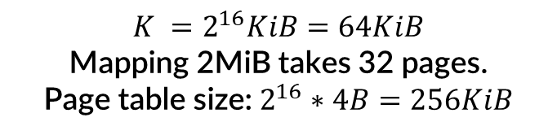
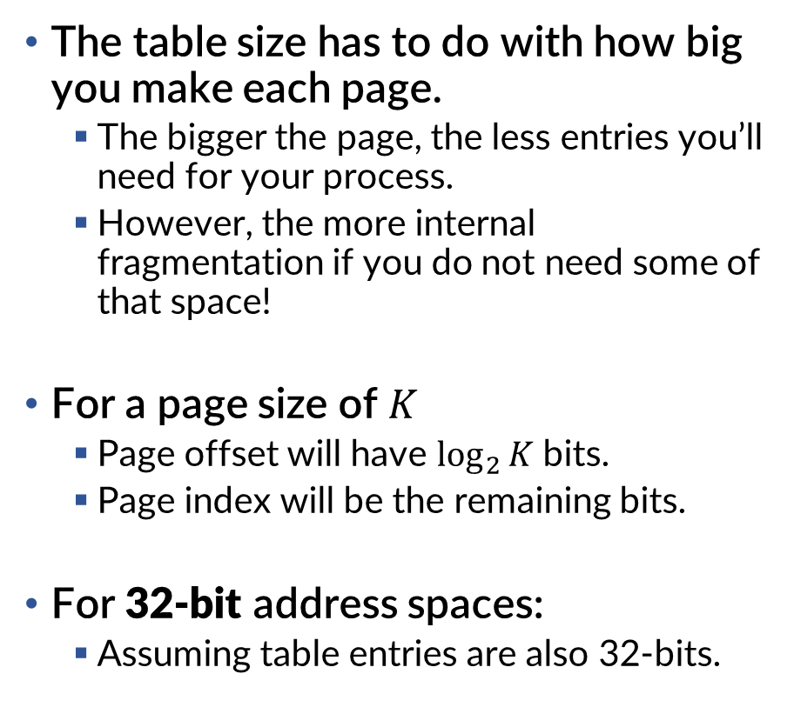


Addressing the granularity issue
Virtual Address
The table size has to do with how big you make each page.
  The bigger the page, the less entries you’ll need for your process.
  However, the more internal fragmentation if you do not need some of that space!
For a page size of $K$
  Page offset will have $\log_{2}{K}$ bits.
  Page index will be the remaining bits.
For 32-bit address spaces:
  Assuming table entries are also 32-bits.
Page Index | Page Offset
0001010101100100 | 0011001001000010
$$K =2^{16}KiB=64KiB$$
Mapping 2MiB takes 32 pages.
Page table size: $2^{16}∗4B=256KiB$
Page Index | Page Offset
00010101011001000011 | 001001000010
$$K =2^{12}KiB=4KiB$$
Mapping 2MiB takes 512 pages.
Page table size: $2^{20}∗4B=4MiB$
Page Index | Page Offset
000101010110010000110010 | 01000010
$$K =2^{8}B=256B$$
Mapping 2MiB takes 8192 pages.
Page table size: $2^{24}∗4B=64MiB$

Slide 31
Inverted Page Tables
There are many strategies for maintaining the metadata that maps virtual addresses to physical addresses.
Now we will look at the inverted page table.
In this strategy, we switch things around: we have just one table for the whole system and an entry for every possible physical page.
CPU
Virtual Address
Page Index | Page Offset
1564 | 3242
Physical Address
Page Index | Page Offset
???? | ????

Slide 32
Address Fields
Virtual Address
In this case, you have a single table for the entire system.
When translating, you scan the table to find an entry that contains the page index.
  This may be intensive!
When you do, and it is valid, make a note of the index of the entry. That is the physical page index.
Page Tag | Page Offset
1564 | 3242
Inverted Page Table
Page Tag | Valid | Write | Execute
... | ... | ... | ...
0d34 | 1 | 0 | 0
1564 | 1 | 1 | 0
066f | 0 | 0 | 0
... | ... | ... | ...
Index
:0af1
:0af2
:0af3
Physical Address
Page Index | Page Offset
???? | ????
0af2
3242

Slide 33
Process Isolation
Virtual Address
Process ID
Many processes exist, and each may use the same virtual address.
  And expect a different physical page!
Since there is only one table on the entire system, we have to disambiguate.
Therefore, we also tag by the process identifier.
Page Tag | Page Offset
1564 | 3242
4157
Inverted Page Table
Page Tag | Process ID | Valid | Write | Execute
... | ... | ... | ... | ...
1564 | 4632 | 1 | 0 | 0
1564 | 4157 | 1 | 1 | 0
066f | 4157 | 0 | 0 | 0
... |  | ... | ... | ...
Index
:0af1
:0af2
:0af3
Physical Address
Page Index | Page Offset
???? | ????
0af2
3242

Slide 34
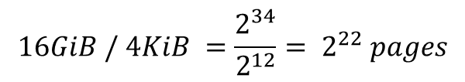

What’s the size??
One nice feature of an inverted page table is the size is bound.
Since an inverted page table has an entry for every possible physical page…
  You can simply allocate the table of a fixed size big enough to represent all of physical memory.
The size of the table is the product of the entry size and the number of physical pages.
Inverted Page Table
Page Tag | Process ID | Valid | Write | Execute
... | ... | ... | ... | ...
1564 | 4632 | 1 | 0 | 0
1564 | 4157 | 1 | 1 | 0
066f | 4157 | 0 | 0 | 0
... |  | ... | ... | ...
20 bits
9 bits
If the page size (K) is 4KiB and our system has 16GiB of RAM, how big is the inverted page table?
$$16GiB / 4KiB ={\frac{2^{34}}{2^{12}}= 2}^{22} pages$$
$2^{22} pages ∗32 bits$ $= 2^{22} pages ∗4B$
$2^{24}B$ $=2^{4}2^{20}B=16MiB$

Slide 35
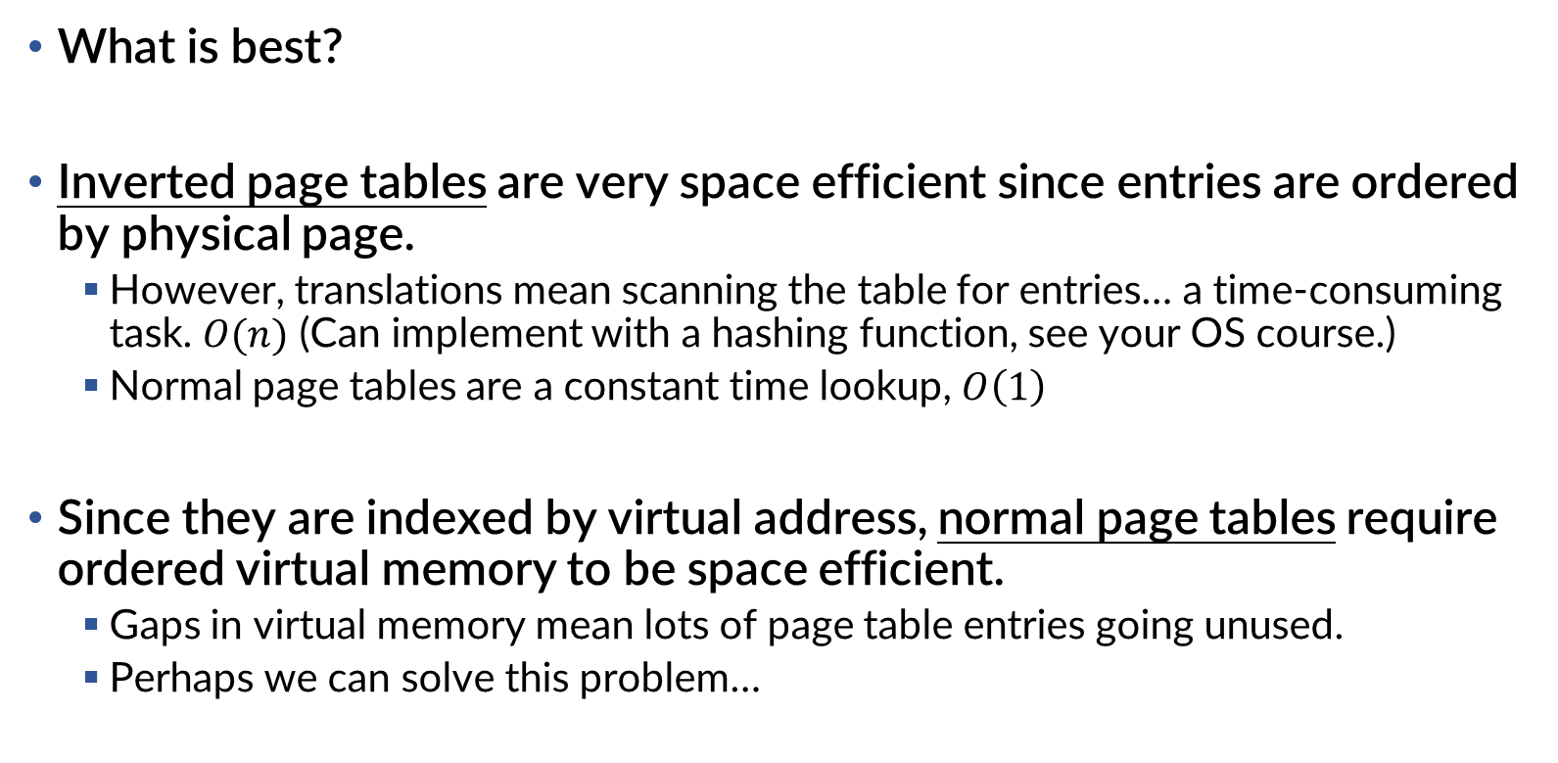
Trade-offs. Trade-offs everywhere!
… Who even knows.
What is best?
Inverted page tables are very space efficient since entries are ordered by physical page.
  However, translations mean scanning the table for entries… a time-consuming task. $O(n)$ (Can implement with a hashing function, see your OS course.)
  Normal page tables are a constant time lookup, $O\left(1\right)$
Since they are indexed by virtual address, normal page tables require ordered virtual memory to be space efficient.
  Gaps in virtual memory mean lots of page table entries going unused.
  Perhaps we can solve this problem…

Slide 36
Multi-level Page Tables (Not a pyramid scheme)
Perhaps we can allow gaps in virtual memory if we use MORE INDIRECTION!
The use of multiple levels of indirection gives a lot of flexibility in defining the virtual address space.
Each page table is the size of a page. (4KiB)
32-bit Virtual Address (0x00400242)
Page Table
Root Address
Second Index | First Index | Page Offset
0000000001 | 0000000000 | 001001000010
2nd Level Page Table
1st Level Page Table
0x?????242
DRAM

Slide 37
Indirection times two
We split up the virtual address into further index fields.
The top-level index yields the real
physical address of
the page containing
the next page table.
This table is used to determine the referred physical page.
32-bit Virtual Address (0x00400242)
Page Table
Root Address
Second Index | First Index | Page Offset
0000000001 | 0000000000 | 001001000010
2nd Level Page Table
Index
Valid | Write | Execute | Page Table Address
1 | 1 | 0 | 0e2f3
1 | 0 | 0 | 0af25
... | ... | ... | ...
0 | 0 | 0 | 00000
0:
1:
…:
1023:
1st Level Page Table
(Real 0x0af25000)
Index
Valid | Write | Execute | Page Address
1 | 1 | 0 | 043f3
0 | 0 | 0 | 05625
... | ... | ... | ...
0 | 0 | 0 | 0dd4e
0x043f3242
0:
0x?????242
1:
…:
DRAM
1023:

Slide 38
Home, home on the [memory] range
Each entry in the top-level page table represents an entire range of memory.
Here, the 2nd level index is 0x1. This represents all virtual memory addresses with the most significant binary digits: 0000000001
32-bit Virtual Address (0x00400242)
Page Table
Root Address
Second Index | First Index | Page Offset
0000000001 | 0000000000 | 001001000010
2nd Level Page Table
Index
Valid | Write | Execute | Page Table Address
1 | 1 | 0 | 0e2f3
1 | 0 | 0 | 0af25
... | ... | ... | ...
0 | 0 | 0 | 00000
0:
1:
…:
1023:
1st Level Page Table
(Real 0x0af25000)
Index
Valid | Write | Execute | Page Address
1 | 1 | 0 | 043f3
0 | 0 | 0 | 05625
... | ... | ... | ...
0 | 0 | 0 | 0dd4e
Maps 4KiB virtual page starting at 0x00400000
0:
Maps 4KiB virtual page starting at 0x00401000
1:
. . .
…:
Maps 4KiB virtual page starting at 0x007ff000
1023:

Slide 39
It’s a sparse world, after all
By marking entries invalid in the top-level page table, this invalidates the entire memory range.
Attempting to access such a virtual address would immediately page fault.
32-bit Virtual Address (0x00400242)
Page Table
Root Address
Second Index | First Index | Page Offset
1111111111 | 0000000000 | 001001000010
2nd Level Page Table
Index
Valid | Write | Execute | Page Table Address
1 | 1 | 0 | 0e2f3
1 | 0 | 0 | 0af25
... | ... | ... | ...
0 | 0 | 0 | 00000
0:
1:
…:
1023:
No 1st level table.
Therefore: all virtual addresses between
0xffc00000 and 0xffffffff
are not mapped (and are not referenceable.)

Slide 40
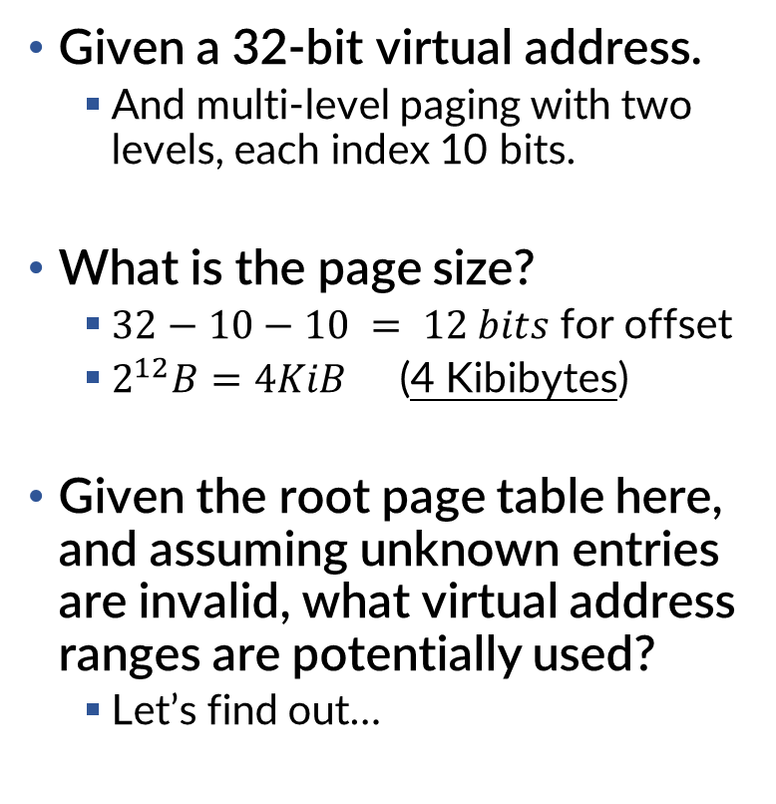
A got a sparsity jacket, but it was just the sleeves.
32-bit Virtual Address
Given a 32-bit virtual address.
  And multi-level paging with two levels, each index 10 bits.
What is the page size?
  $32−10−10 = 12 bits$ for offset
  $2^{12}B=4KiB$ (4 Kibibytes)
Given the root page table here, and assuming unknown entries are invalid, what virtual address ranges are potentially used?
  Let’s find out…
Second Index | First Index | Page Offset
10 bits | 10 bits | ??????
2nd Level Page Table
Index
Valid | Write | Execute | Page Table Address
1 | 0 | 1 | 0e2f3
0 | 0 | 0 | 00000
... | ... | ... | ...
0 | 0 | 0 | 00000
1 | 1 | 0 | 0b3d8
0 | 0 | 0 | 00000
... | ... | ... | ...
0 | 0 | 0 | 00000
1 | 0 | 0 | 0af3d
0:
1:
…:
255:
256:
257:
…:
1022:
1023:

Slide 41
Continuing: Filling in the blanks
32-bit Virtual Address
Given the root page table here, and assuming unknown entries are invalid, what virtual address ranges are potentially used?
Second Index | First Index | Page Offset
10 bits | 10 bits | 12 bits
00000000000000000000000000000000 to
00000000001111111111111111111111
2nd Level Page Table
Index
Valid | Write | Execute | Page Table Address
1 | 0 | 1 | 0e2f3
0 | 0 | 0 | 00000
... | ... | ... | ...
0 | 0 | 0 | 00000
1 | 1 | 0 | 0b3d8
0 | 0 | 0 | 00000
... | ... | ... | ...
0 | 0 | 0 | 00000
1 | 0 | 0 | 0af3d
Maps virtual pages from 0x00000000 to 0x003fffff
0:
1:
01000000000000000000000000000000 to
01000000001111111111111111111111
…:
255:
Maps virtual pages from 0x40000000 to 0x403fffff
256:
257:
11111111110000000000000000000000 to
11111111111111111111111111111111
…:
1022:
Maps virtual pages from 0xffc00000 to 0xffffffff
1023:

Slide 42

Best of both worlds.
32-bit Virtual Address
With multi-level page tables, we can represent large ranges of memory with gaps, much like segments!
  All the while, we can satisfy each individual page in this “segment” by interleaving them throughout physical ram. (flexibility, no external fragmentation)
Modern architectures often use
multi-level page tables.
  x86-64 uses a 4 level page table!
Second Index | First Index | Page Offset
10 bits | 10 bits | 12 bits
Page Table
Root Address
2nd Level Page Table
1st Level Page Table
Maps virtual pages from 0x00000000 to 0x003fffff
Maps virtual pages from 0x40000000 to 0x403fffff
Segments?
(kinda)
DRAM
Maps virtual pages from 0xffc00000 to 0xffffffff

Slide 43
Summary
So, we have many complex processes running at the same time.
How to present a consistent address space?
  Indirection using segments or page tables.
  We translate virtual addresses to physical addresses.
How to prevent other processes from interfering?
  We can mark segments or individual pages with access controls. (Read-only, non-execute, etc.)
How to prevent address space fragmentation?
  We give each process its own address space.
  When we context switch, we switch address spaces.

